Slide 1

Dr. Charles Severance
Founder, Learning Experiences
drchuck@learnxp.com

Slide 2

A framework to build, host, and integrate learning applications

Slide 3


Like a rhinestone cowboy – offers coming in over the phone
www.tsugi.org
The Year of Tsugi – 2019
LTI Advantage Certified
Became the first test platform fir all the major vendors
Helped converge interoperability
Tsugi Django Workshops
Apereo 2020, Canvas, D2L, Blackboard, Apereo Africa
Build Django for Everybody
www.dj4e.com

Slide 4
I can see clearly now, the rain has gone. I can see all obstacles….
www.tsugi.org
The 2020 Tsugi Pivot (again)
Build some tools for teachers
Make running a server easy for adopters
Invest in the LOR authoring experience and stand alone MOOC features
Notes:
James taylor - https://www.youtube.com/watch?v=3WJ1cf3nrLE

Slide 5
Winter, spring, summer or fall, all you got to do is call…
www.tsugi.org
Ready to Use Tools
CKEditor + Document Annotation
PDF + Sticky Notes = StickyGrader
In progress – Summer Project
Threaded Discussion based on NYU discussion - Django
https://www.tsugicloud.org/tsugi/store/details/ckpaper
Notes:
James taylor - https://www.youtube.com/watch?v=3WJ1cf3nrLE

Slide 6
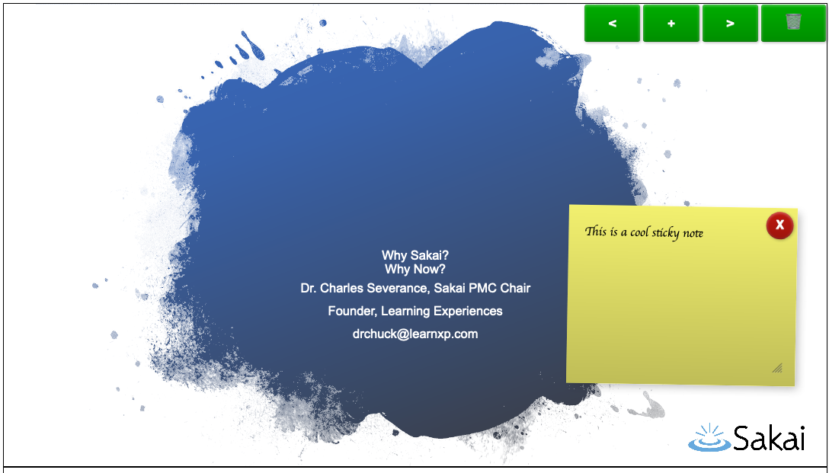
https://www.tsugicloud.org/tsugi/store/details/stickygrader

Slide 7
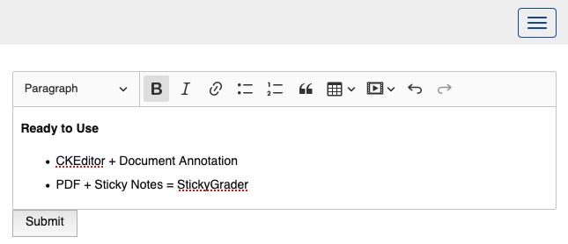
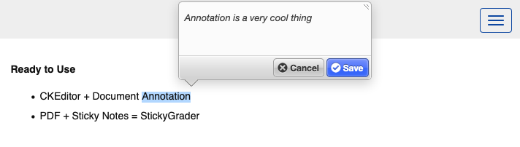
https://www.tsugicloud.org/tsugi/store/details/ckpaper

Slide 8
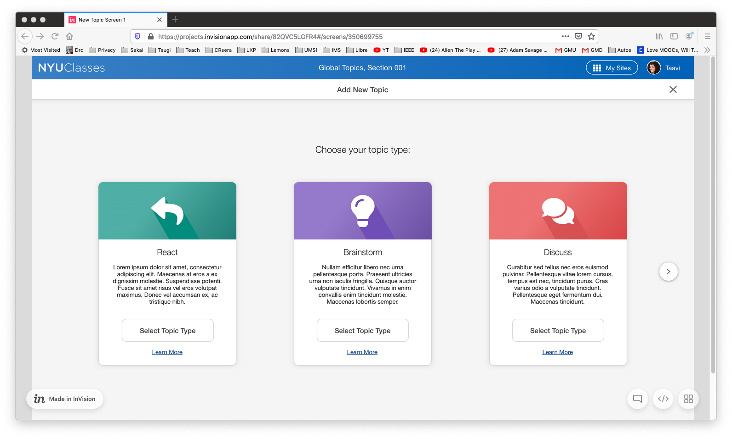

Slide 9


When people see a cool tool, they like the tool but then they think about more tools… ☺
www.tsugi.org

Slide 10
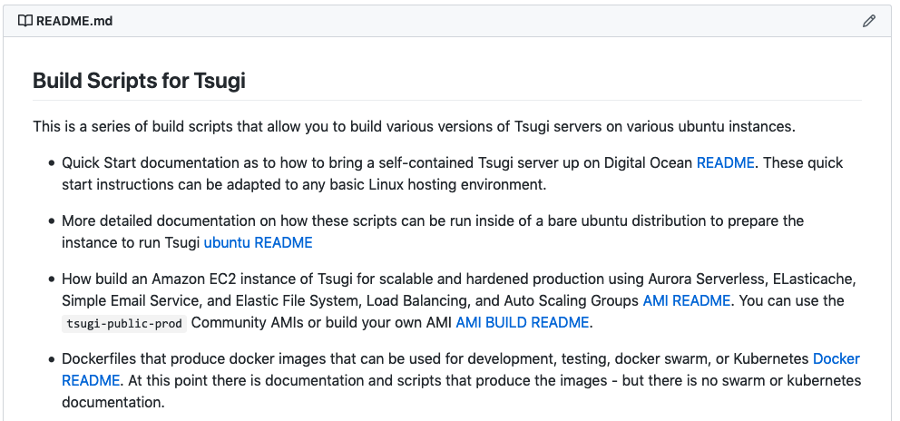
https://github.com/tsugiproject/tsugi-build

Slide 11
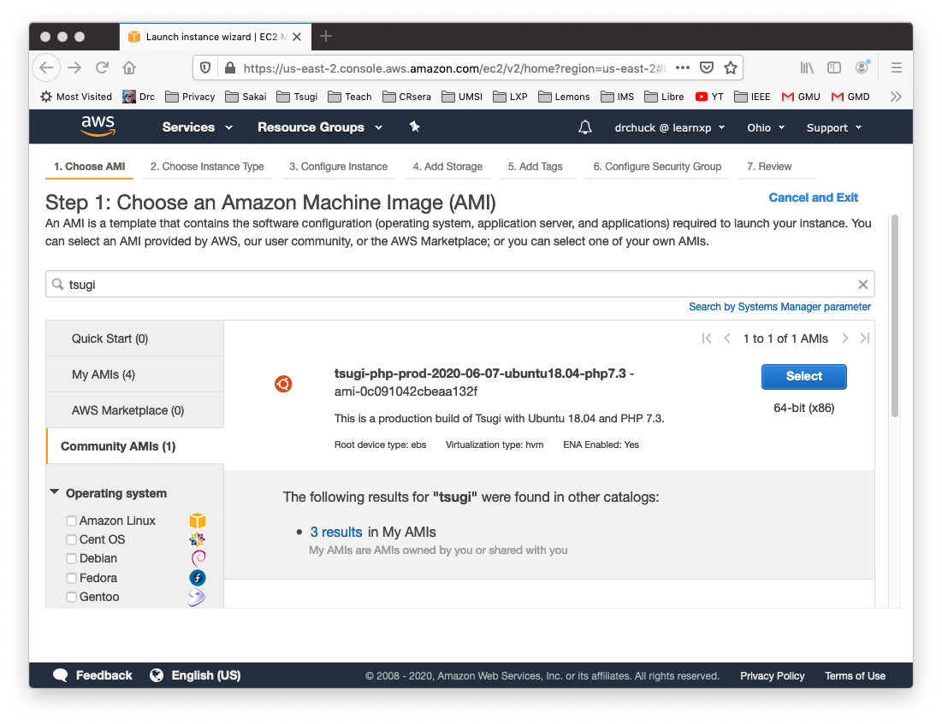

Slide 12
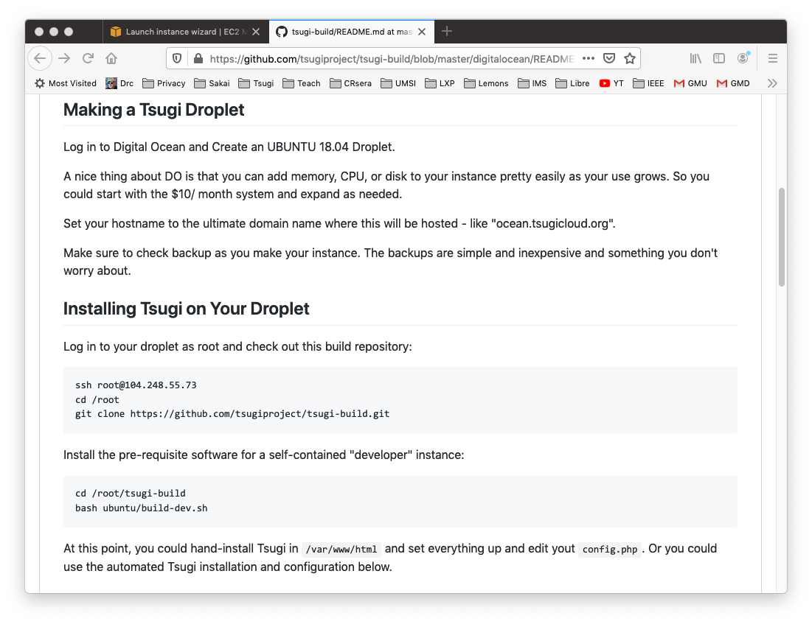

Slide 13


TODO: Improve this UI
LTI Apps
Pages
Files
Graders
Book
LOR/MOOC py4e.com
Autograders (次)
Modules
OER Content (코스)
IMS
Canvas
edX
Pandoc
Coursera
KDP
Media
FutureLearn
archive.org
YouTube
Amazon
ITunes
Google Play

Slide 14
www.tsugi.org
Tsugi 2020-2021
Tools, tools, and more tools
I want to make “self-hosting” easy again – on Amazon :)
Understand scalable Django hosting
Improve Course authoring and hosting
Django for Everybody on Coursers, edX, and FutureLearn
Winter, spring, summer or fall, all you got to do is call…
https://www.tsugicloud.org/tsugi/store/details/ckpaper

Slide 15
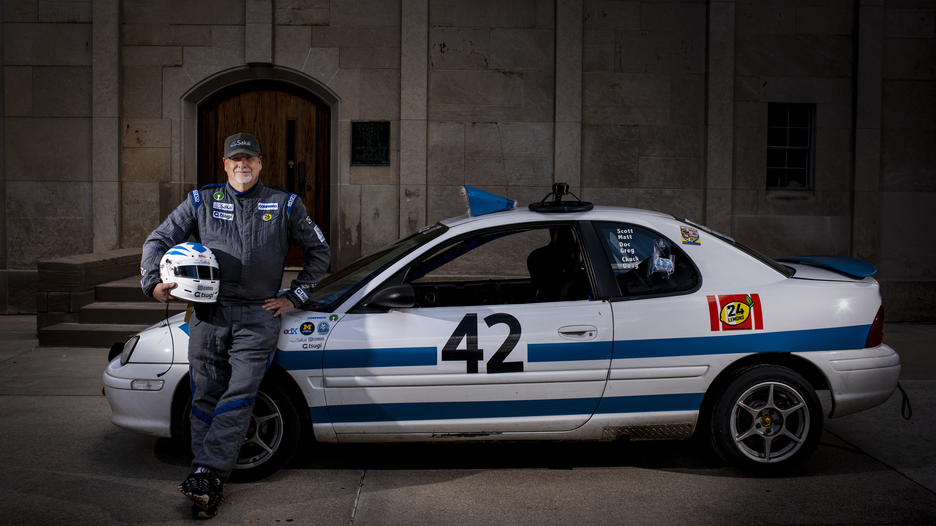
Tsugi / Koseu
Charles R. Severance
www.tsugi.org
Photo: Jeffrey Smith

